Slide 1
AVTR Bogie 2.0
Dt 30.09.2022

Slide 2
Contents
Bogie 2.0 – (Rear suspension/ Rear axle)
Proposal details
3. Time line and Budget estimate

Slide 3
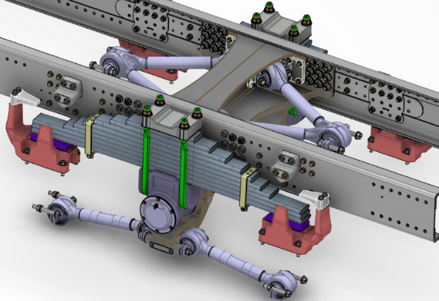
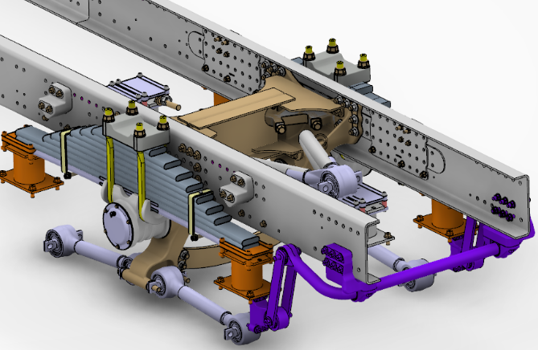
Existing Vs Proposed
Existing
Proposed
Single casting for two Bogie bkts integrated with X-member.
Metal spring seat on axle.
Separate Bogie bkts with fabricated X-member.
Rubber Bolster on axle with ARB.

Slide 4
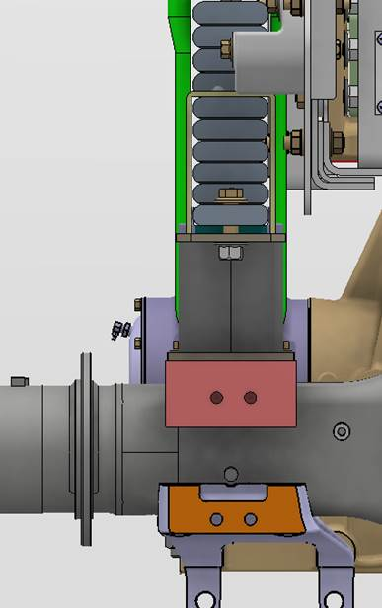
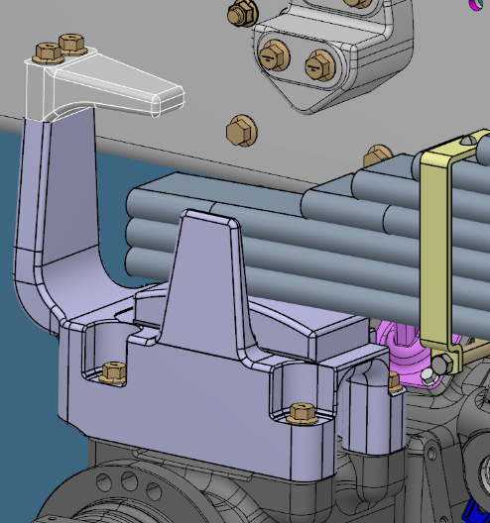
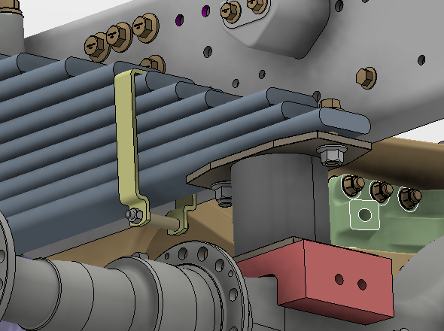
Wear Pad vs Rubber Bolster
Metal spring seat
Rubber Bolster
Leaf Spring
(First leaf)
Rubber bolster
(Layer of metal plates covered with Rubber)
Leaf Spring
Metal wear pad
Axle
Spring seat
Axle

Slide 5
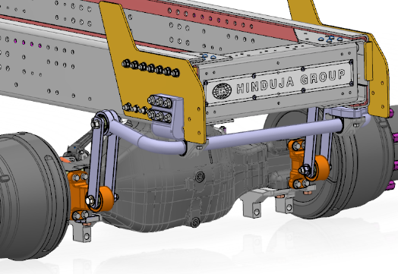
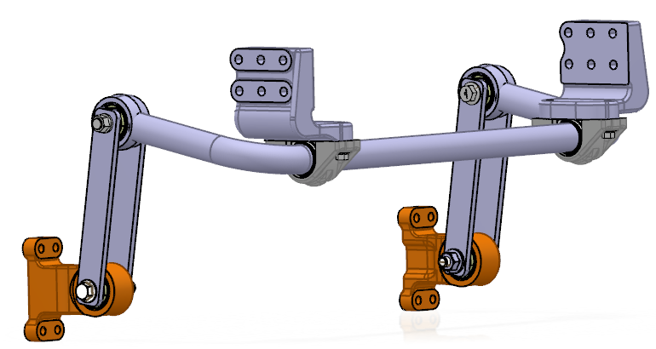
Rear ARB
SHOULD cost based on weight and front ARB- Rs 12,000/-
Total assy weight – 69 kg (SR)/ 75 kg (HR)
Frame bkt (casting)
Anti Roll Bar (ARB)
Silent bloc bush
Bottom cup (casting)
Split bush
Discrete part list:
1. ARB (only length change from BS4)
2. Frame bkt
3. Axle bkt(Integrated for SR/Bolton for HR)
4. Link rod (only length change BS4)
5. Bottom cup
Link rod (plate)
Axle bkt (casting)
ARB mtg provision is already available in HR axle housing and to be incorporated in Single reduction axle

Slide 6
Contents
Bogie 2.0 – (Rear suspension/ Rear axle)
Proposal details
3. Time line and Budget estimate

Slide 7
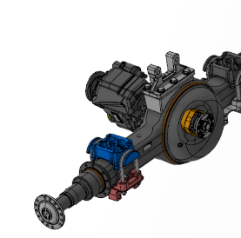
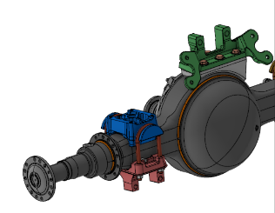
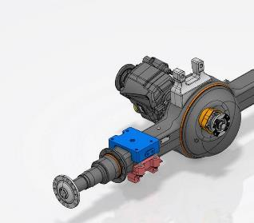
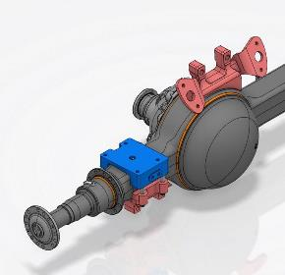
Rear axle proposal – Bogie 2.0
RA1
RA2
Existing
Existing
Proposed
Proposed
All dimensions are in mm

Slide 8
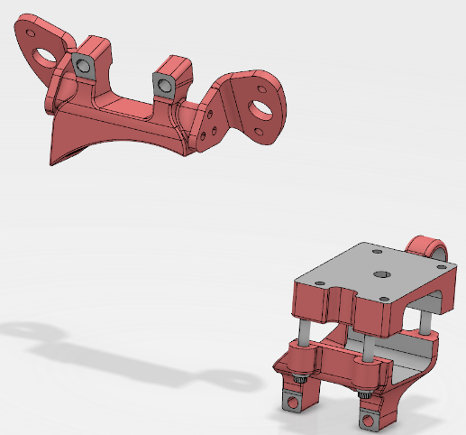
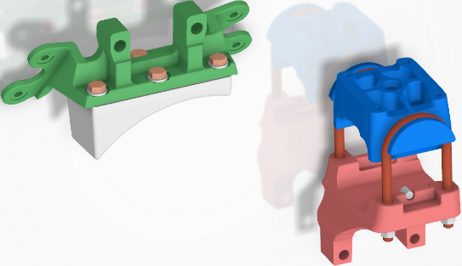
Existing BS6 vs Bogie 2.0 – Brackets
Proposed – Bogie 2.0
Existing – BS6
V Rod Bracket - Welded
V rod Bracket (Bolted)
Middle Block
Wing Brackets - bolted
Top Pad - Welded
Ubolt M20
Middle Block
Spl Bolt – M20x2.5
Bottom Clamp
Bottom Clamp

Slide 9
Total weight saving in Bogie 2.0 at vehicle level
Weight saving:-
 | Existing Bogie (Without ARB) | Bogie 2.0 (With ARB) | Difference | Saving at vehicle level
Rear suspension and brackets | SR axle- 1249 HR axle- 1287 | SR axle- 1149 HR axle- 1155 | SR axle-100 HR axle-132 | 184 (SR)
Rear axle and brackets | SR axle - 250 | SR axle – 166 | SR axle - 84
Value in Kg
Indicative cost saving is
INR 29,931/-

Slide 10
Contents
Axle housing strain measurement summary
Existing BS6 Bogie
BS6 Bogie with lower spring stiffness
BS6 Bogie with Rubber Bolster
BS4 Bogie
Bogie 2.0 – (Rear suspension/ Rear axle)
Proposal details
Weight and cost details
3. Time line and Budget estimate

Slide 11
S1 – 16th Nov’22
S2 (CBN release) – 10th Mar’23
S3 (CBN release) – 19th May’23
Time plan
Month | Aug'22 |  |  |  |  | Sept'22 |  |  |  | Oct'22 |  |  |  |  | Nov'22 |  |  |  | Dec'22 |  |  |  | Jan'23 |  |  |  |  | Feb'23 |  |  |  | Mar'23 |  |  |  | Apr'23 |  |  |  | May'23 |  |  |  |  | Jun'23 |  | Jul'23
Week number | 32 | 33 | 34 | 35 | 36 | 37 | 38 | 39 | 40 | 41 | 42 | 43 | 44 | 45 | 46 | 47 | 48 | 49 | 50 | 51 | 52 | 53 | 1 | 2 | 3 | 4 | 5 | 6 | 7 | 8 | 9 | 10 | 11 | 12 | 13 | 14 | 15 | 16 | 17 | 18 | 19 | 20 | 21 | 22 | 23 | 26 | 27 | 31
Phase 3
Concept design for rear suspension
Concept design for rear axle
Budget approval
Phase 4
Detailed design and CAE - Rear suspension
Detailed design and CAE - Rear axle
Stage 1 - Rear suspension |  |  |  |  |  |  |  |  |  |  | S1
Stage 1 - Rear axle |  |  |  |  |  |  |  |  |  |  |  |  |  |  |  | S1
Phase 5
Parts development - Rear suspension
Parts development - Rear axle
In house testing - 6P Trials with Rubber Bolster in existing Bogie
In house testing - 6P Trials with Final Bogie and Rubber Bolster
Supplier/ CTL tests -Rear axle
In house testing - Strain measurement for Bogie bracket in Pave and Customer sites
Stage 2 - Rear suspension |  |  |  |  |  |  |  |  |  |  |  |  |  |  |  |  |  |  |  |  |  |  |  |  |  |  |  |  |  | S2
Stage 2 – Rear axle |  |  |  |  |  |  |  |  |  |  |  |  |  |  |  |  |  |  |  |  |  |  |  |  |  |  |  |  |  |  |  | S2
Stage 2 - CBN release |  |  |  |  |  |  |  |  |  |  |  |  |  |  |  |  |  |  |  |  |  |  |  |  |  |  |  |  |  |  |  | S2
Phase 6
Plant fitment trials and sign off
Field trials in worst case Tipper applications (HR vehicle field conversion) – 2000 hrs
Field trials in worst case Tipper applications (Plant built SR vehicles) – 2000 hrs (Rear suspension)
Stage 3 release - Rear suspension |  |  |  |  |  |  |  |  |  |  |  |  |  |  |  |  |  |  |  |  |  |  |  |  |  |  |  |  |  |  |  |  |  |  |  |  |  | S3
Stage 3 release – Rear axle (600 Hrs validation) |  |  |  |  |  |  |  |  |  |  |  |  |  |  |  |  |  |  |  |  |  |  |  |  |  |  |  |  |  |  |  |  |  |  |  |  |  |  |  |  |  | S3
Stage 3 release – CBN release |  |  |  |  |  |  |  |  |  |  |  |  |  |  |  |  |  |  |  |  |  |  |  |  |  |  |  |  |  |  |  |  |  |  |  |  |  |  |  |  |  | S3

Slide 12
Investment Estimate
Inputs for estimate:-
1 vehicle for 8P validation
1 vehicle for performance test
No separate vehicle planned for Homologation
4 HR vehicle conversion in Field for trials
4 SR vehicle built at Plant for field trials
2 set of vehicle spares for testing
PD investment estimate – INR 197 L
PD
Proto cost (2 vehicles) : 60 L
Parts and spares : 90 L
Performance and component test : 25 L
Homologation cost : 15 L
Development
Development estimate – INR 422.45 L
438.45
Rubber bolster : 13.45 L (Proto)/ 89 L (Production) Bogie bracket : 20 L (Proto)/ 50 L (Production) Trunnion : 10 L ARB brkt : 5 L Bogie 2.0 cross member : 15 L (Proto)/ 55L (Production) V Rod bracket (RA1/RA2) : 20 L (Part tooling cost) SBA wing brackets : 4 L (Part tooling cost) Middle block/ spring seat : 8 L (Part tooling cost)- 24 Bottom clamp (LH/RH) : 24 L (Part tooling cost) Mounting bolt : 5 L (Part tooling cost) Integral brake : 25 L Integral brake – Torque plate : 25 L | Additional part tooling cost for HR axle V rod : 10 L V Rod bracket : 20 L Bottom clamp : 24 L
Total estimate
619.45 L
635.45
Notes:-
Scope – Axle brackets are in Meritor scope
Tooling Cost for brake and axle brackets to be validated with Sourcing/ Suppliers
Axle brackets for 18TG SR variants can be made with additional m/c in 16TG Brackets – If tooling decided, budget required shall be INR 52L/-

Slide 13
Thank you

